Slide 1
Team v3

Slide 2
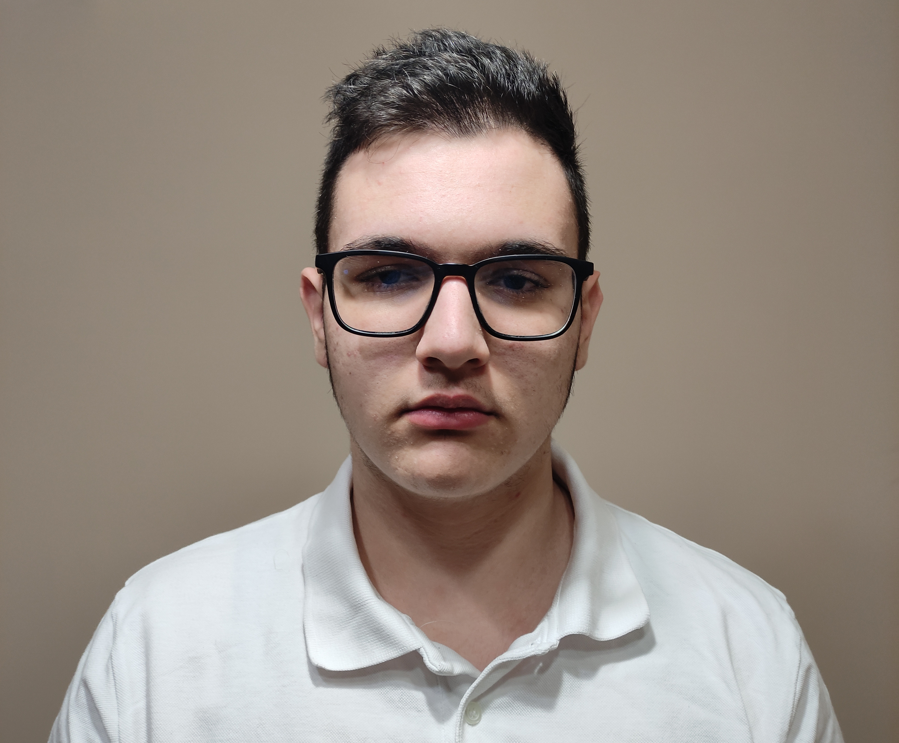
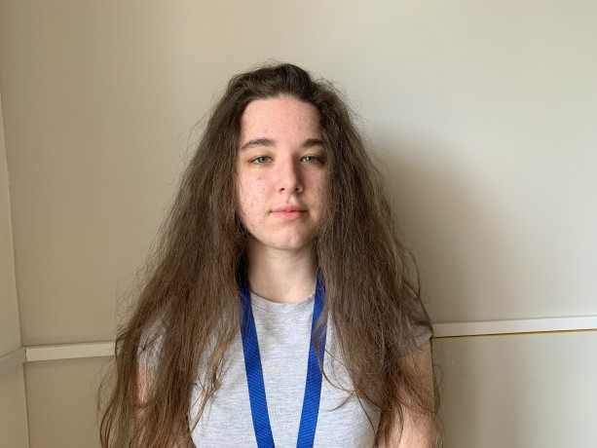
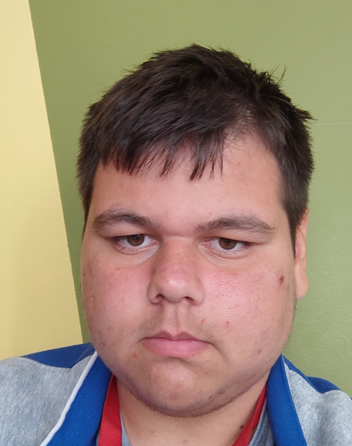
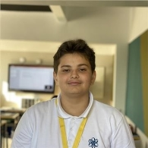
Team Members
Team v3
Dimitar Yoldov
{Back-end}
Kristiqna Stoikova
{Back-end}
Ivan Draganov
{Q&A}
Kaloyan Kuzmanov
{}

Slide 3
Process
Forming the team
01
02
Start of the project
Troubleshooting
Finishing the project
03
04

Slide 4




Programs we used

Slide 5
Thanks for watching

